Slide 1
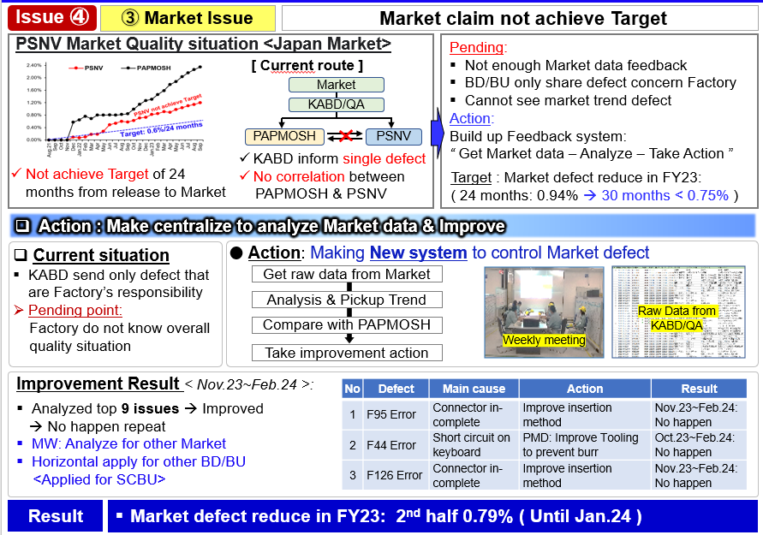

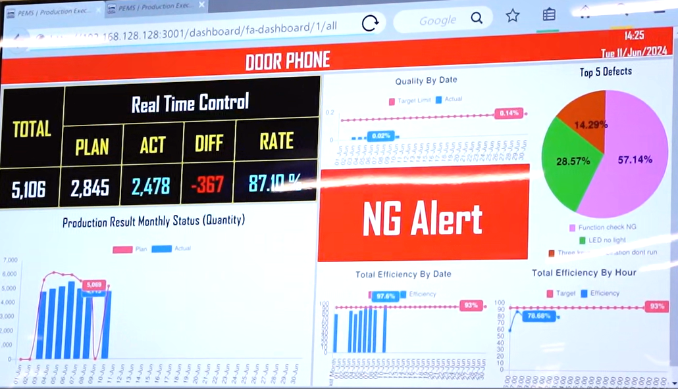







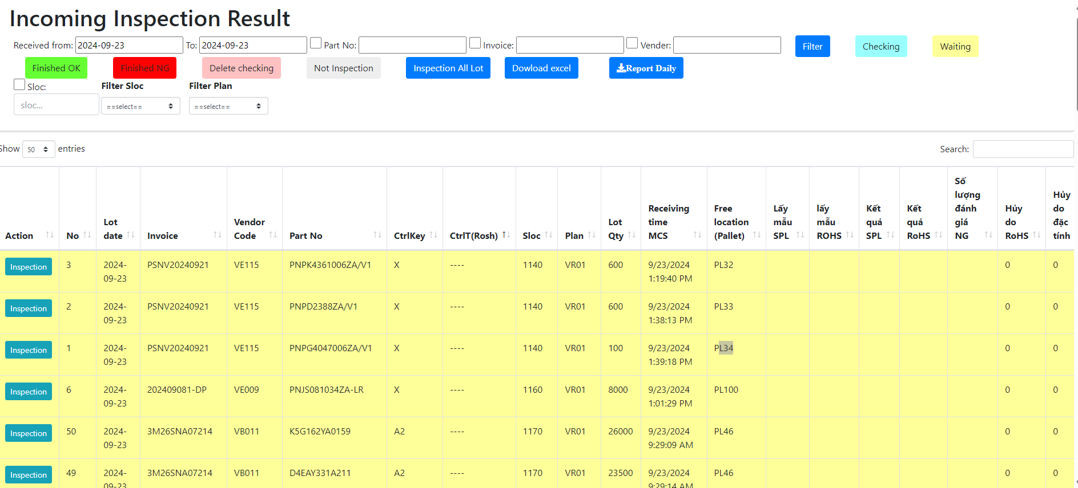

Link weight check system concept
1
OQC inspection
PEMs server
Defect issue
OQC
Pick sample
OQC
Judge
FA warehouse
(E-map control)
SCM warehouse
Return sample
WMS
NEW SYSTEM
Database server
Weight check FA
FA In/Out location
FA create Pallet ID
Visualize OQC inspection result

Slide 2


Link weight check system concept
Production
OQC visualize system
Shipment
PEM system
Record 4M change
Process quality issue
Purpose
Indicate process 4M/ Quality each Lot
Visualize OQC checking status
Indicate shipment permission
Trace back for Market feedback
VMS system
Visualize status of model following shipment plan daily
Link final confirmation to WMS/PDA
ADD
ADD
ADD
ADD
Weight check system
Production result
Link with ID pallet system
Shipment request (Priority)
Advantage
Remove manual Job FA/OQC/SCM
Eliminate human risk & follow up quality /4M issue to evaluate LOT
Visualize shipment permission timely
ADD
Visualize OQC inspection result
Link
Link
Link
PEM
System
Weight check
System
OQC system
ID pallet
VMS
System
Shipment
Production : △… H
QC : △2pax
SCM : △… H
Auto system replace manual Job and visualize quality /4M information to evaluate Lot for shipment

Slide 3
Defect system

Slide 4

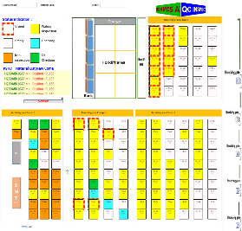
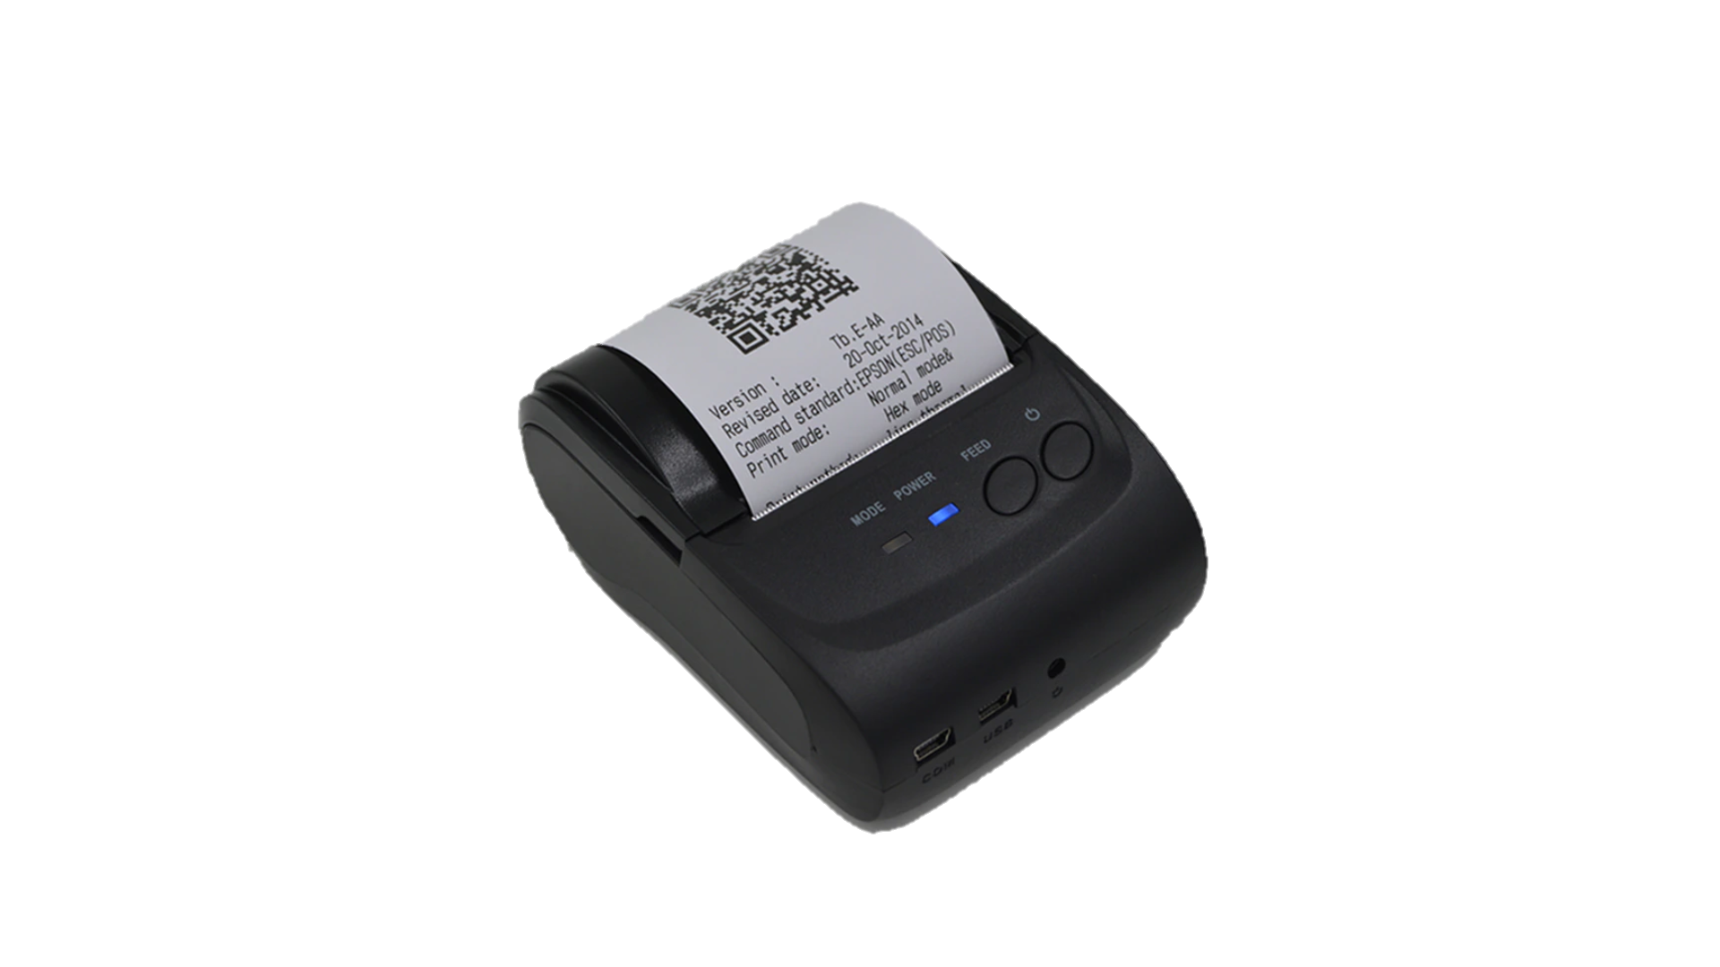




SMART WAREHOUSE MANAGEMENT CONCEPT
1/3
① RECEIVING
② STORING
③ KITTING
④ SUPPLY
CURRENT
Receiving is not indicated on SAP
Manual print receiving card manual find & paste
Manual back flush
Manual control position by Excel file
Manual find location to store
Manual record INPUT qty to stock card
Manual transfer on SAP another store
Manual find location to kitting
Manual record OUTPUT qty to stock card
Manual control FIFO when kitting
Manual control kitting position
Auto transfer
Manual find trolley
put material
FOSS classify
Vendor
FA sub
Material centralize
Sub material
Control
inventory
No-storing
FOSS classify
FOSS
❸
non inspection
inspection
J.I.T area
J.I.T
1.Have barcode max 80%
2.No barcode 20%
(New supplier/cost up)
Free Receiving
[Done FY22]
Storing E-map [New]
Kitting E-map [New]
❶
3.Add barcode
8 a.m
7 a.m
6 a.m
[New]
JIT
❹
- Free
location rack
- E-map
control
Kitting
Kitting
Prepare OK
FA line

Need storing
direct print
receiving card
E-map trolley
Inhouse
(PMD/OCS/FA)
FOSS classify
direct print
Part card
Add mobile printer
Auto backflush
Storing part
Auto transaction
❺
E-map kitting
❷
Data synchronization
FOSS
Manual Auto control position by E-map
Manual Auto find location to store
Manual Scan INPUT qty to unit barcode
Manual Auto transfer on SAP another store


❶ ❷ ❸
❸ ❹ ❺
❸ ❹
Receiving is not indicated on SAP
Manual Auto print receiving card manual find & paste
Manual Auto back flush
Manual Auto find location to kitting
Manual Scan OUTPUT qty to unit barcode
Manual control FIFO by system
Manual Control kitting position by E-map
Proposal
Auto transfer
Manual Auto find trolley put material
AFTER
HC
reduce
∆2pax
∆4pax [LFC: ∆2pax]
∆8pax [LFC: ∆5pax]
∆1pax
∆15pax [LFC: ∆10pax]

Slide 5
Link weight check system concept
1
① Pick up sample
② OQC inspection
③ Chop stamp
④ Shipment
OQC manual control sample: Q’ty, serial No ..
FA not know box OQC pick up
Manual control weight check
Not update inspection result
Manual make report
OQC: Manual find pallet
FA/SCM: Manual confirm Pallet status
Manual confirm product lot status
CURRENT
OQC
Pick sample
OQC inspection
FA warehouse
(E-map control)
OQC Judge
SCM warehouse
WMS
Return sample
NEW SYSTEM
Database server
Weight check FA
FA In/Out location
FA create Pallet ID
Visualize OQC inspection result
System indicate S/N OQC pickup & inspection progress
System indicate OQC & Lot judgment
Eliminate manual job OQC
➔ Save: 1,000H/year
E-chop and indication on system
FA: Save 213.4$/year
OQC: ∆2pax
E-chop and indication on system
SCM: Save 800H/year
AFTER

Slide 6
Project members
2
Hien IT
Project Manager
Minh IT
Project Leader
OQC
Member
FA
Member
SCM
Member
Add
Member

Slide 7
Project Schedule
3
Sept W3
Sept W4
W1.Oct
W2.Oct~
Nov
Dec
Jan.25
Project 01
Project Establishment &
Environment Preparation
Project plan & Approve
11/9/2024
Project 02
Concept scope confirm
System design & develop
23/9/2024
Project 03
Functions confirmation
Unit Test
Functions confirmation
Unit Test
1/11/2024
Project 04
SIT
UAT
1/12/2024
Project 05
GO-LIVE
20/1/2025
Notes:
KH cũ: 12,1,2,3.2025

Slide 8
Details of OQC pickup sample & chop stamp
4
Details current procedure from PCS → FA → OQC → SCM
OQC pick up & Return sample
PCS issue Pro plan
Production plan
Pick up sample
Reading barcode Inner/Outer 1st
Weight check 1st
OQC Normal inspection
Reading barcode Product / Inner
Weight check 2nd
Reading barcode Inner/Outer 2nd
Return to Pallet
①
②
③
④
⑤
⑦
⑧
⑨
⑩
SCM shortage
FA confirm stock
Reliability
inspection
⑥
OQC chop stamp
Report daily
Chop stamp physical all lots
Find all lots same model, shift, Line
Record Pallet ID & S/N carton
Matching Pallet ID & Outer carton box
Find Pallet ID&F/G
⑯
⑮
⑭
⑬
⑫
⑪
FA/SCM
FA
warehouse
FA
ID pallet
Scan ID pallet to receive by PDA
Confirm receiving by WMS
⑰
⑱
⑲
⑳
Current situation:
Pickup & Return sample → Manual Job at process: ① ~ ⑦
Chop stamp: Loss time to find pallet → Manual Job at process: ⑪ ~ ⑯
Need to improve

Slide 9
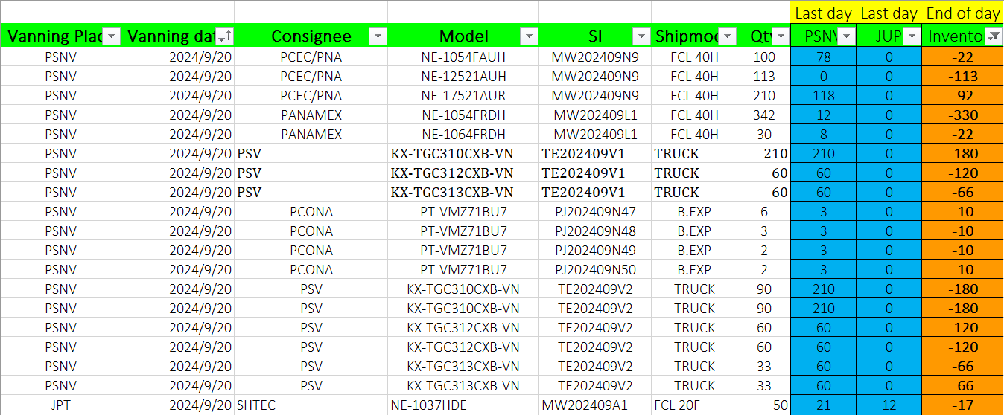
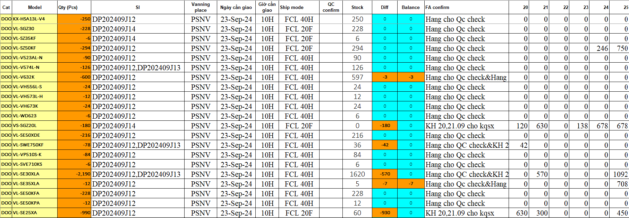
① Confirm shortage shipment
5
OQC confirm shipment plan to focus priority shipment models by manual
◆ Current
◆ Proposal
Step 1: SCM send inventory & shipment plan
Request system will be displayed details:
Indicate priority shipment model to announce OQC pick up inspection
Indicate details: Ship by Board/Air, Stock Q'ty, shipment Q’ty, Minus product compare vs shipment plan
Minus product: Q’ty, Reason, when re-running (need indicate)
In case production plan be changed → Auto refresh
Classify type of product and display : EMC, PP, PMP and can shipment or not (Ex: PP cannot shipment..)
Step 2: FA update inventory & shipment plan
IT confirm: Hưng Đạo sẽ trả lời về lấy dữ liệu hàng thiếu (SCM xác nhận tiếp)
➔ OQC cấp IT file của OQC hnay (excel chi tiết) → 4-OCt
Step 3: OQC input shipment info to focus check priority
Using time: 5 mins/day*4 BD/BU =20 mins/day
Save time: 20 mins/day

Slide 10
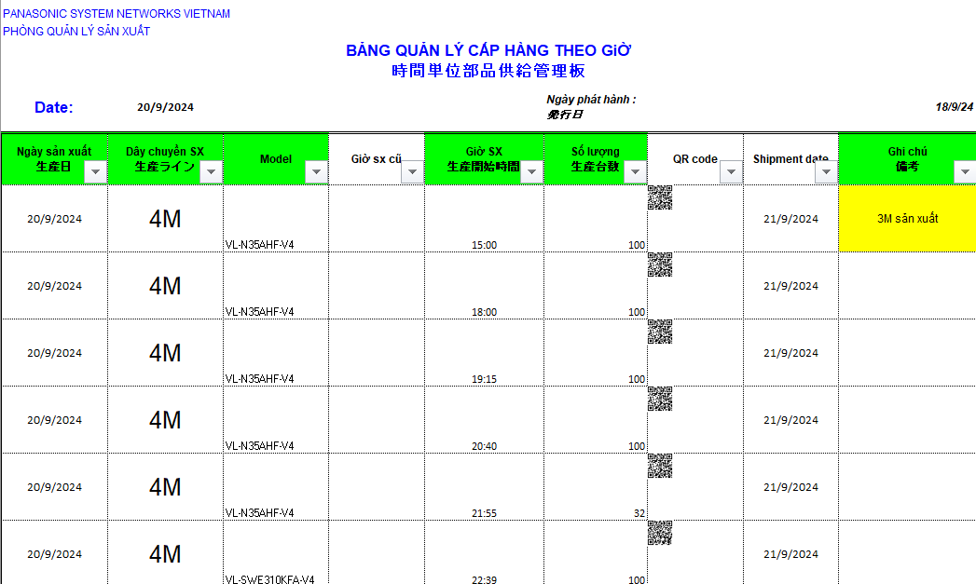
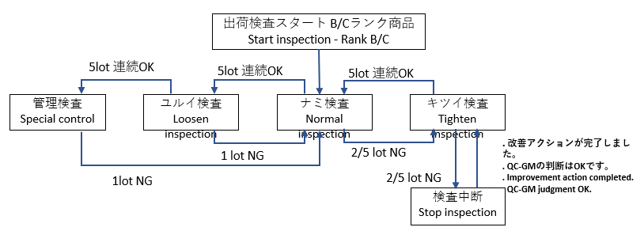
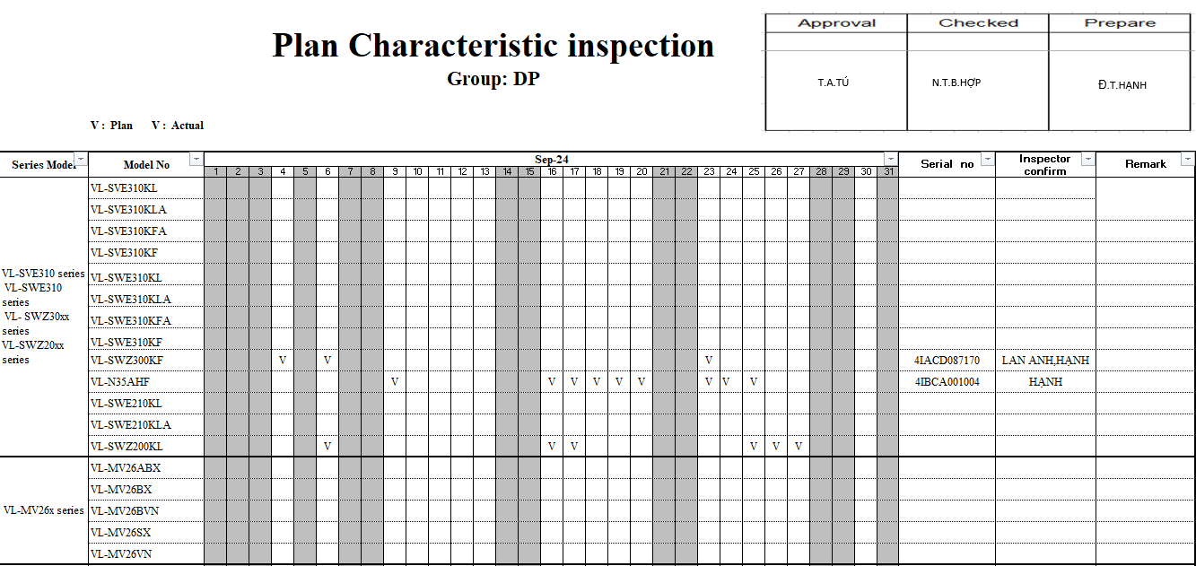
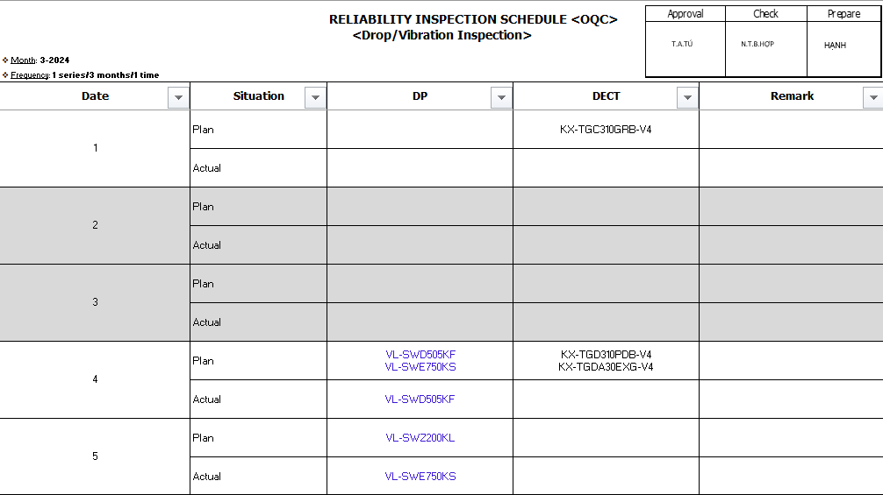
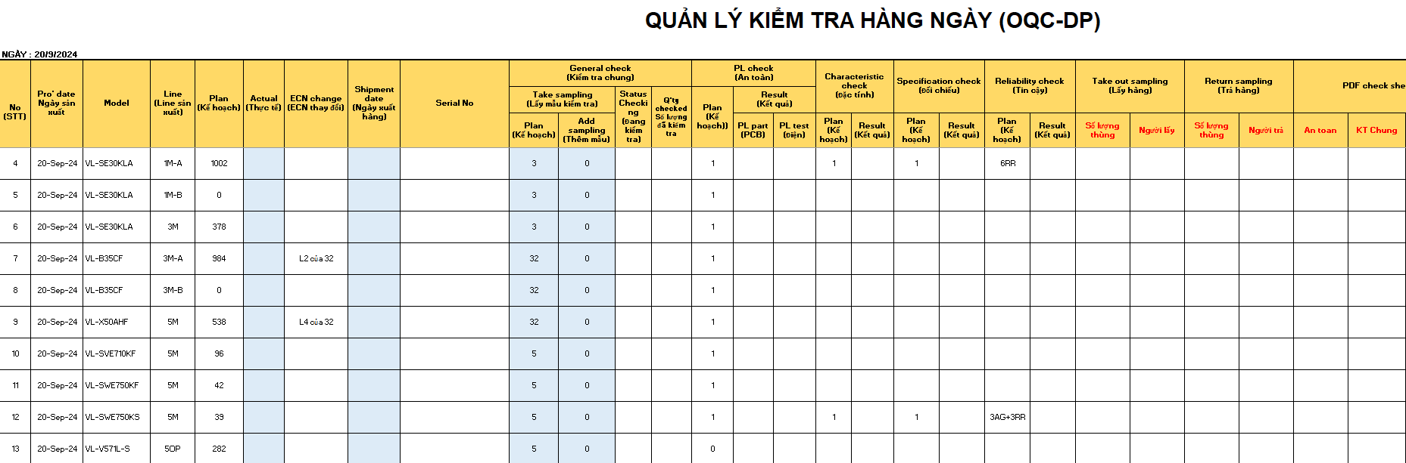
① OQC re-make production plan
6
OQC re-making production plan base on production plan that PCS send
◆ Current
◆ Proposal
Step 1: PCS send Daily production plan <Email/Server>
OQC make database: Sample Q’ty; Reliability plan
Q’ty sample Standard
Plan
Plan
System will be linked with OQC Inspection plan:
OQC sampling Q’ty (Incase if happen Quality issue, sample Q’ty level will be changed → Return to previous level → OQC make Data base)
Add : 1 column for adjust sample if need to follow up quality issue
Auto assign model that should be Reliability test
Auto change sample Q’ty level (Ex: Normal level → Loosen level)
If cannot catch up plan → Can adjust and display reason (Only OQC member can revise)
Step 2: OQC copy into OQC format to control
OQC re-making production base on information of PCS:
Add some information: Sample Q’ty, PL, Characteristic, Reliability, Specification…
➔ Using time: 10 mins/day
➔ OQC cấp IT file của OQC đang làm hiện tại (excel chi tiết) → 3-OCt
System will link with OQC inspection plan and auto update:
➔ Save time: 10 mins/day

Slide 11
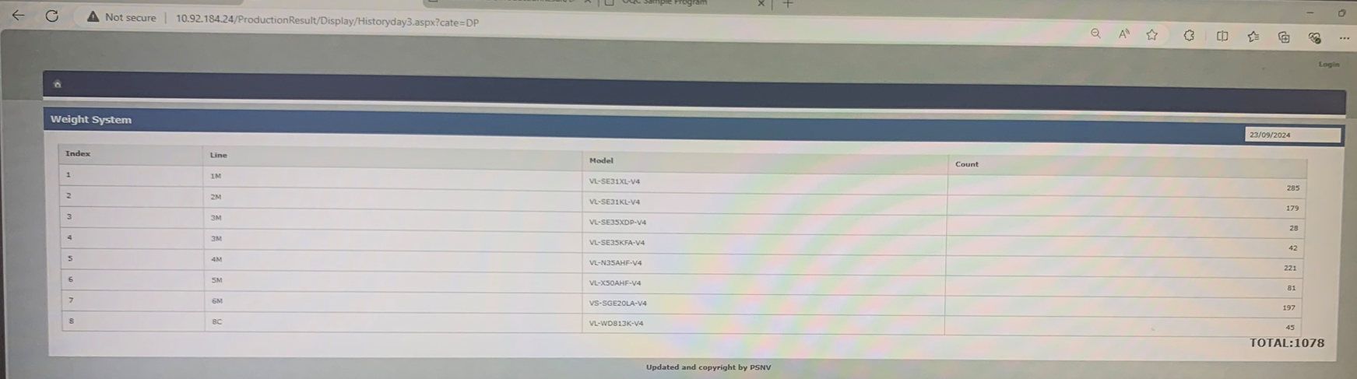
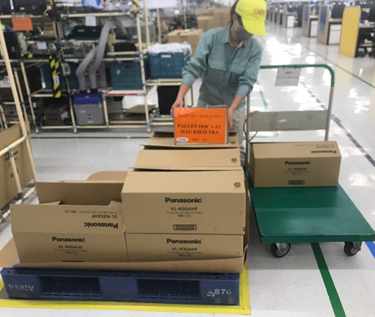
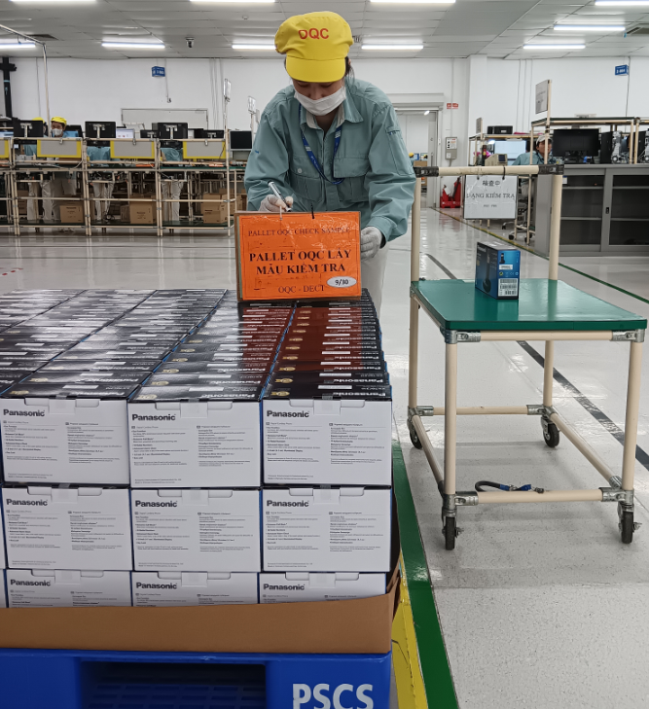
② OQC pick up sample
7
OQC pick up sample follow serial range
◆ Current
◆ Proposal
Step 1: Access PSNV Portal to confirm Production result
System can be indicated:
Scan barcode of Outer box → Displays Outer box OQC pick up: FA easy to control sample quantity OQC pick up
System will remind OQC to pick up sample
Indicate time OQC pick up sample on system
Indicate pallet OQC pick up sample to eliminate finding and scan barcode many times
Step 2: Divide serial range to pick up sample at Pallet
DP
DECT
Pick up outer box & put indication
Pick up inner box & put indication
Using time: 1mins*8 times/day=8 mins/day
Save: 8 mins/day

Slide 12
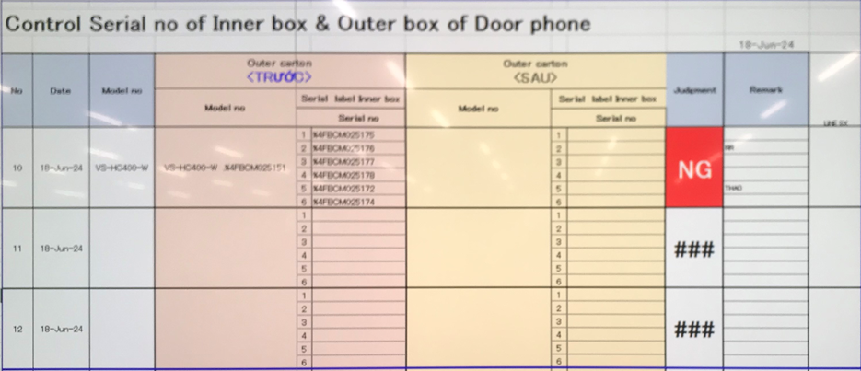
③ Reading barcode Inner/Outer 1st time
8
Confirm Outer carton and inner box
◆ Current
◆ Proposal
Reading Barcode of Outer box and Inner box
System link weight check system to confirm Outer box includes which inner boxes
Purpose: To confirm Outer box includes how many inner box and which serial No
Using time: 30lots*10sec*2Outer boxes=10mins/day
Save: 10 mins/day

Slide 13
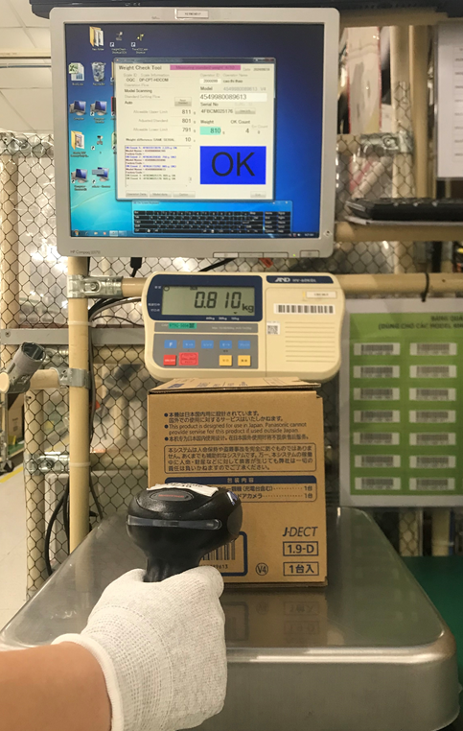
④ Weight check 1st time
9
Weight check offline at OQC to confirm accessory
◆ Current
◆ Proposal
Weight check 1st time (Control offline):
System link weight check system to weight of inner box
Purpose: To confirm full inner box before un-packing
FA already applied weight check system: No need add this point ➔ No need do weight check 1st at OQC
Using time: 150pcs*5sec*2 BD/BU=24mins/day
Save: 24 mins/day

Slide 14
⑤ OQC Normal inspection
10
OQC normal inspection
◆ Current
◆ Proposal
Current inspection procedure
System link with Database sample Q’ty:
After OQC finish inspection → System indicate result of each serial No (In case NG will be indicated NG situation and reason NG)
System auto confirm matching sample Q’ty with database to indicate changing situation
+ System alarm if inspect duplicated serial No
+ Save history of sample check → Can Traceability
Incase FA happen quality issue → How to indication on system (Prevent OQC judgment OK when FA happen NG) → How to return product of this lot?
Confirm the number of samples to be taken
Appearance check
Function check
Manual confirm sample Q’ty enough or not
Nếu số lượng còn lại của lô mà phát sinh NG thì hệ thống báo FA kết thúc sản xuất để OQC judgment cả lô

Slide 15
⑥ Reliability inspection
11
Reliability inspection:
◆ Current
◆ Proposal
Current inspection procedure
System link with Database sample Q’ty:
OQC make Database about grouping series model need to check Characteristic, Reliability (Monthly)
System auto select model and remind to inspect:
+ Limit Q’ty of model to be suitable with OQC lead time
(For Ex: OQC can check 2pcs characteristic)
+ System default: After Reliability test → Normal inspection.
In case sample not yet checked normal → Will be alarm
+ In case happen Quality issue will be displayed NG situation
and after rework/repair → Change situation (Have history:
Main cause, action)
+ If the model only produced 1 time in a month → Need to
indicate in inspection plan
Confirm checking plan of characteristic, specification, reliability
Basic function check: Power ON check
Inspect: Characteristic, Specification, Reliability
Full function check
Indicate result in OQC control sheet
Bổ sung thêm nội dung vào trang đánh giá lô

Slide 16
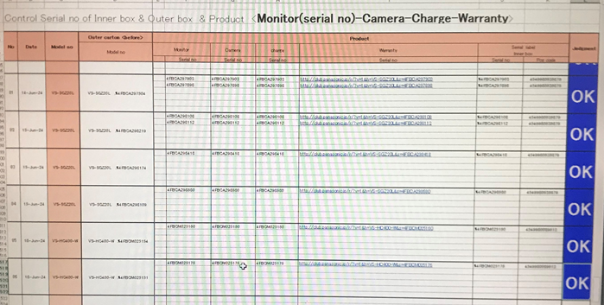
⑦ Reading barcode Product Inner to confirm correct serial No
12
Confirm ingredients of product for ensure matching Serial No
◆ Current
◆ Proposal
Reading barcode Product Inner to confirm correct S/N
Reading barcode Product Inner to confirm correct S/N
OQC make master list product ingredients: Monitor, camera, wireless, charger…
System can auto indicate ingredients must read barcode
Link with FA system to confirm ingredients inside?
This process is re-packing:
+ How to indicate set by set inspection result ?
NG or OK ? Any problem happen ?What is next action ?
+ How this result link to total Judgment ?
Gửi file excel mẫu và master list: 4-OCt

Slide 17
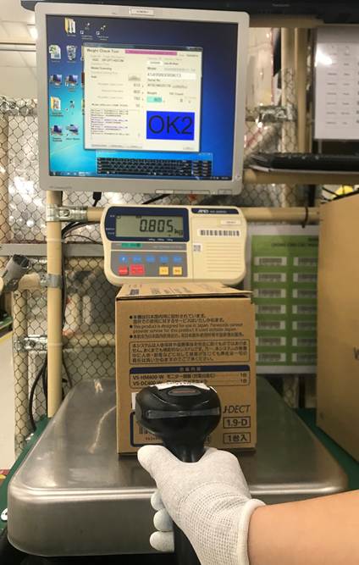
⑧ Weight check 2nd time
13
Current procedure from PCS → OQC → FA → SCM
◆ Current
◆ Proposal
Weight check 2nd time:
Purpose: To confirm full inner box after packing, compare weight check 1st time & 2nd time for judgment
Weight check 2nd time: Auto link with weight check system of FA to compare weight of inner box and Judgment
FA weight check system
Link
How can detect if FA weight check system have trouble ?

Slide 18
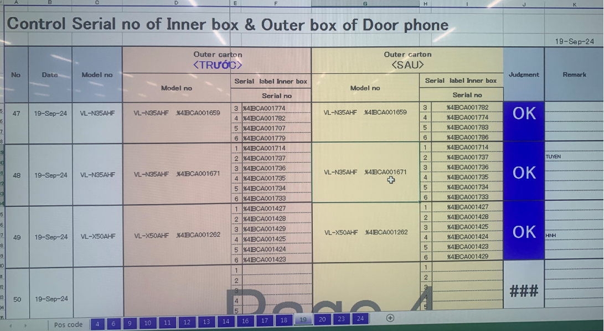
⑨ Reading barcode Inner/Outer 2nd time
14
Confirm matching Outer box with inner box
◆ Current
◆ Proposal
Reading barcode Outer & Inner 2nd time
Purpose: Ensure correct Outer box & Inner box
System auto link with FA weight check system
Scan ID outer → Auto link with FA weight check to compare Outer box & inner box
FA weight check system
Link

Slide 19
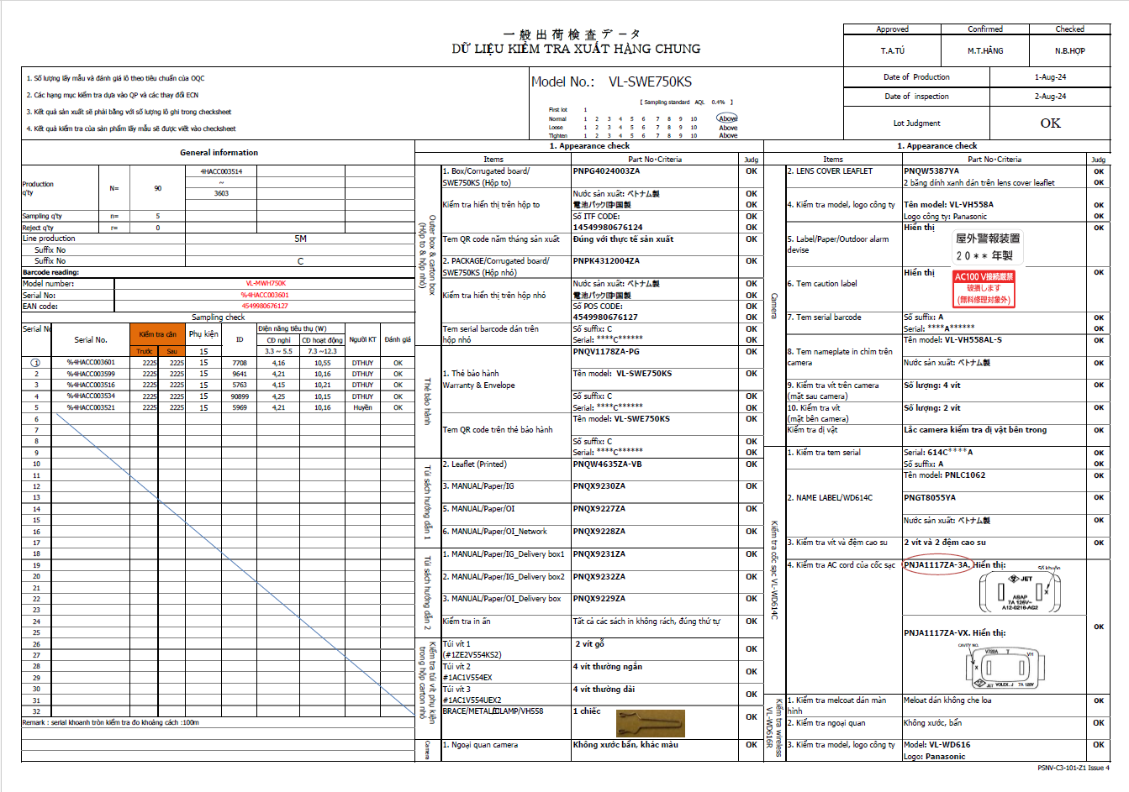
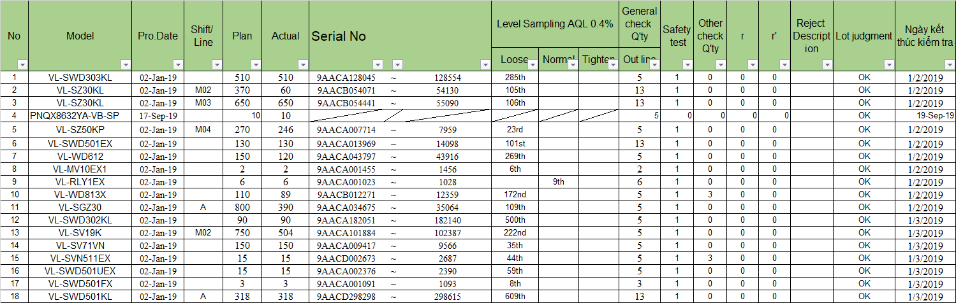
⑯ Output check sheet inspection & Report
15
Record OQC inspection check sheet and report
◆ Current
◆ Proposal
Current situation:
System auto output OQC inspection result
Manual making OQC inspection check sheet:
System auto output: Production Q’ty, Serial range, FA line, Production date, OQC sample serial No, Inspection date, Sample Q’ty
When reading barcode to start inspection : System link and open OQC check sheet. Then OQC check 1pc complete and indicate OK → Link to system for inspection result
Auto output inspection check sheet (Pdf) follow inspection date, lot
Manual input summary OQC inspection result:
Gửi file form báo cáo mẫu: 4-Oct
(Đặc tính, đối chiếu?)
➔ Using time: 10 mins/day
➔Save time: 10 mins/day

Slide 20
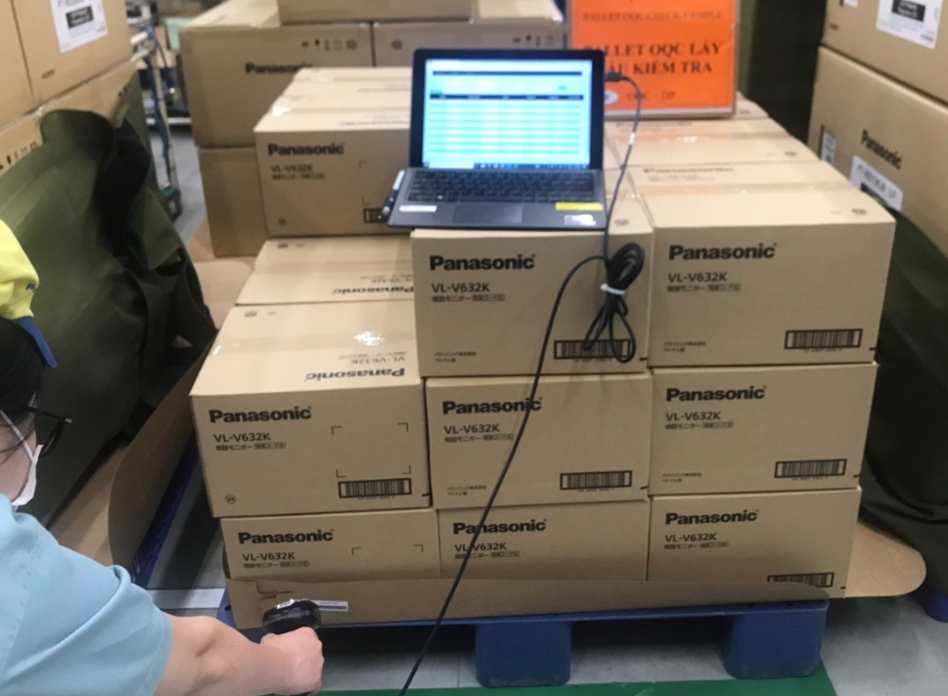
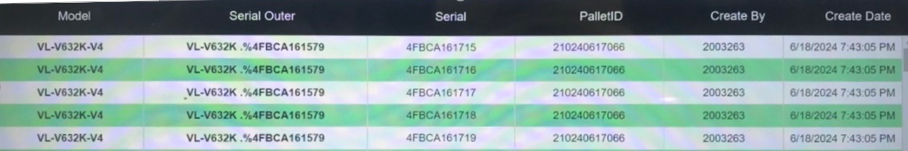
⑪~⑮ OQC chop stamp
16
Current chop stamp procedure
◆ Current
◆ Proposal
Current situation:
System auto indicate judgment lot
Finding pallet to confirm correct model, Q’ty
Indicate Judgment lot on system → All sections can understand lot situation
Eliminate physical chop stamp
How system link with ID pallet station or how to prevent production move to SCM without OQC approval ?
OQC find Pallet ID
Matching ID Pallet and Outer Carton
OQC chop stamp all ID Pallet
Read ID Pallet & S/N carton box by excel file
Find all same model, production date, line, shift
Chop stamp on Pallet sheet
OK
DD-MM-YY
OQC
Đối với các pallet OQC đóng dấu thì FA sẽ kéo ra và để ở khu vực gần thang máy, nếu OK cả lô thì mới cho vào thang máy
Using time:
DP/Dect: 480 mins/day
MW/TV/PJ/SB/PAPVN: 480mins/day
➔Save time: 960 mins/day ~ 2pax

Slide 21
Rule to Judge 1 LOT
17
Identify 1 lot:
There is another model to insert running while current model is running ➔ Switching model time is counted a new lot (Lot: Change another model or finish working shift)
Judgment 1 lot:
OQC will judge lot after finish inspection all sample Q'ty regardless of whether production has ended ➔ THêm điều kiện: OQC finish sample Q’ty + FA finish production
1st sample
2nd sample
……
N sample
Final Judgment for Lot
OK
OK
OK
OK
Làm rõ, bổ sung

Slide 22
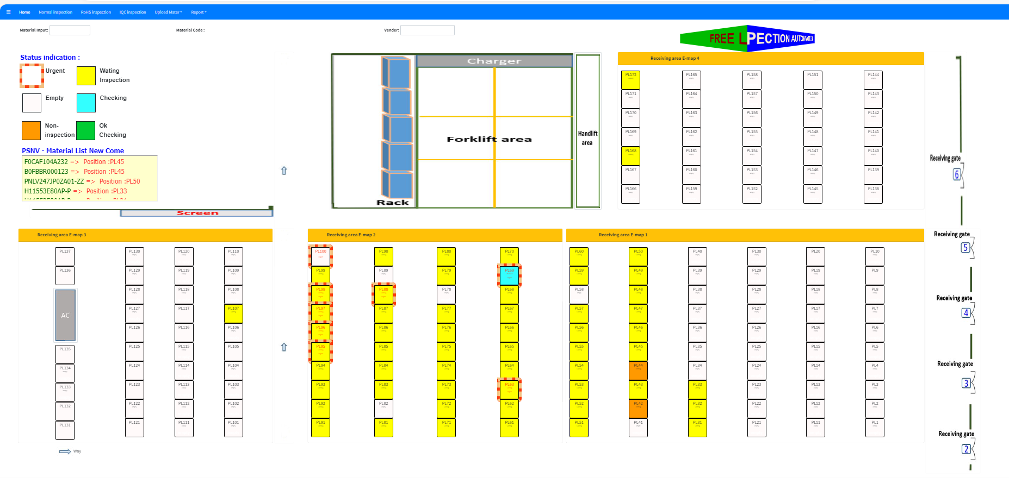
OQC DASH BOARD
18
Visualize status of Lot
Indication location at warehouse
Status situation
Not checked yet
Checking
Checking
<Can move pallet>
OK
NG
Not checked yet : OQC not taken sample yet
Checking : Under OQC checking
Checking : Under OQC checking (Sample Q’ty already checked over a half Q’ty of all sample)
<Can move pallet>
OK : All Lot judgment OK
NG : Lot judged NG
How to control non-inspection pallet ?
Need to decide rule to transfer OK lot to SCM
OQC inspection indication
Location indication at warehouse

Slide 23
Preparation Equipment for system
19
Equipment list up (OQC)
Cat/Equipment |  | DP/DECT | MW | PJ/SB | TV
Tablet (Connect with barcode reader) | Available (pcs) | 1 | 1 | 0 | 0
 | Additional (New) (pcs) | 1 | 0 | 1 | 1
➔ Need to add more 3pcs tablet
FA: xác nhận PDA=?pcs

Slide 24
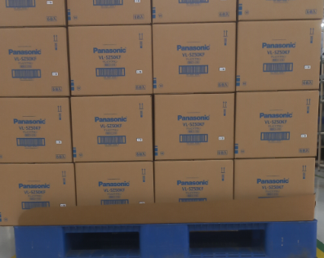

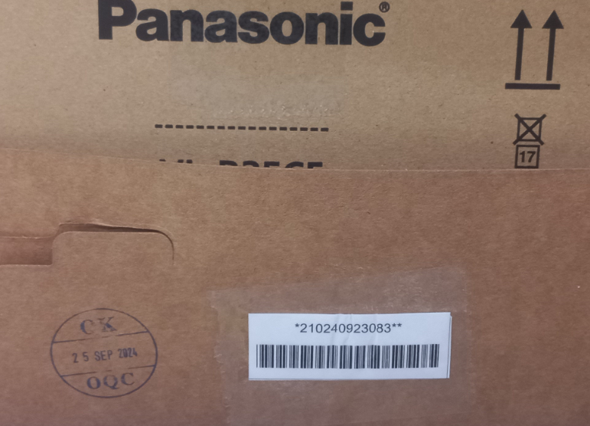
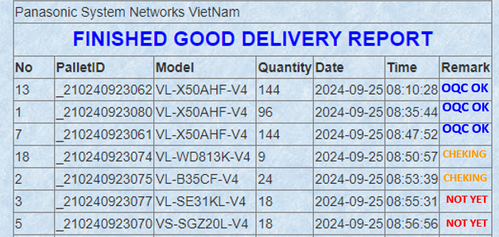
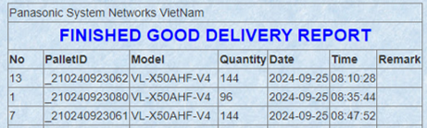
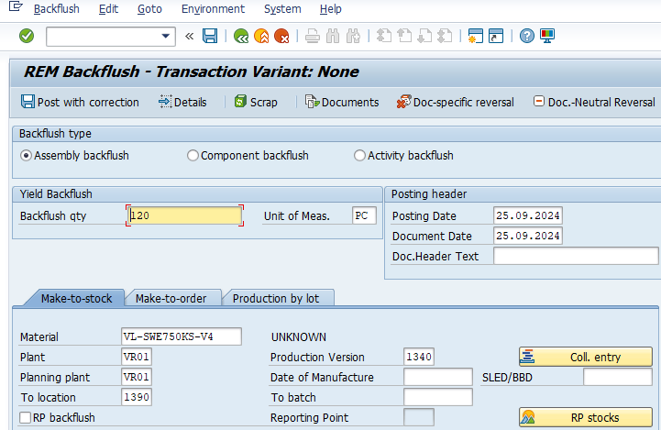
Change method transfer F/G to SCS
FA
20
BEFORE
AFTER
Current process
Improvement process
Production F/G OK
Production F/G OK
FA Make ID ID pallet
FA Make ID ID pallet
Waiting OQC check
Waiting OQC check
OQC stamping OK on slip sheet
OQC stamping OK on System
OQC OK
Manual check OQC OK
OQC OK
Check OQC OK by PDA
OQC OK
Download ID pallet scaned
LINK
Download ID pallet scaned
FA transfer SCS (SAP system)
Auto transfer
SCS (SAP system)
Print movement slip
Print movement slip
SCS Receive the finish goods Scan ID Pallet Code
FA transfer SCS (Actual)
FA transfer SCS (Actual)
Currently
Manual check OQC display OK
Manual transfer F/G to SCS (SAP system)
Printing hard movement slip: 3600pcs/monthly ⬄ 7.2Ream
Cost: 7.2*2.47$ = 17.78$/month ~ 213.4$/Year
Improvement
Check OQC OK by PDA
Auto transfer F/G to SCS (SAP system)
Abolish hard movement slip: 7.2Ream
Save Cost: 213.4$/Year
Reduced : 213.4 S/Y

Slide 25
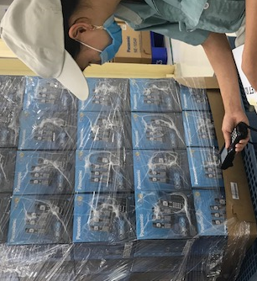
OQC DIGITAL SYSTEM LINK WMS & CONFIRMATION DATA
SCM
21
SCS request:
Visualize status of model following shipment plan daily
Link final confirmation to WMS/PDA for operator working in warehouse
DASHBOARD
LINK WMS/PDA
Option 1
FA
OQC
SCS
WMS
①
Judgement auto email
FA transfer cargo to SCS
Shipment plan
Dashboard
Finish production
Sampling inspection
Shipment plan
*
Option 2
*
①
PSNV Portal
“Control shipping plan”
Pallet ID finish
Warning to dashboard
SCS visualize on pallet
②
Scan ID pallet
Result NG
FA/QC recheck
Judgement OK
Judgement OK
Scan ID pallet to receive
Result judged OK
Confirm data PDA
③
Email auto
Confirm receiving
Auto update
③
WMS
SCS check all data by download
**
Confirm receiving
**
Dashboard
Format check

Slide 26
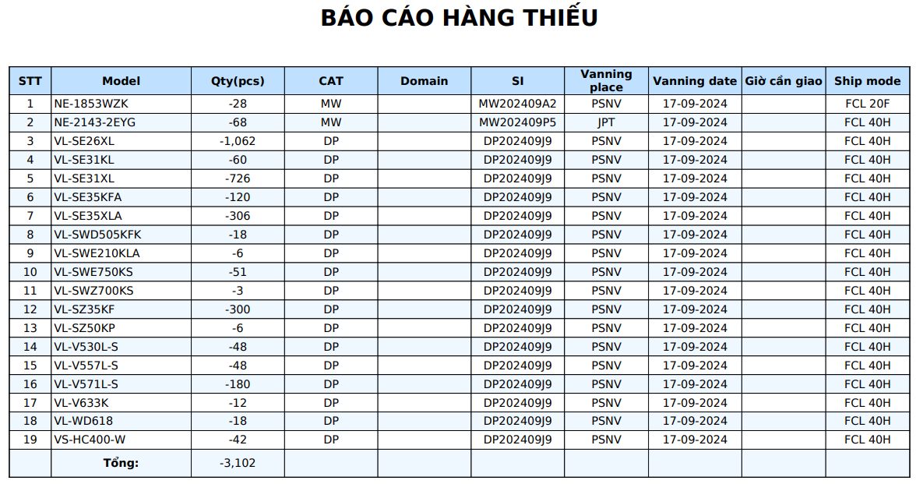
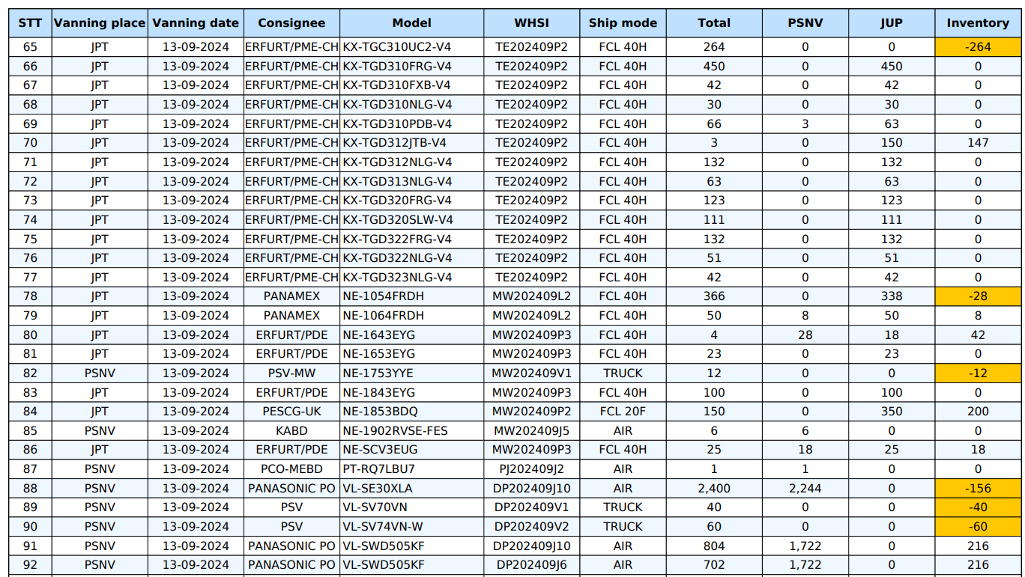
OQC DIGITAL SYSTEM LINK WMS & CONFIRMATION DATA
22
Details shortage shipment plan daily on WMS
Shortage shipment plan daily on WMS
FORMAT DOWNLOAD FROM DASHBOARD

